Slide 1
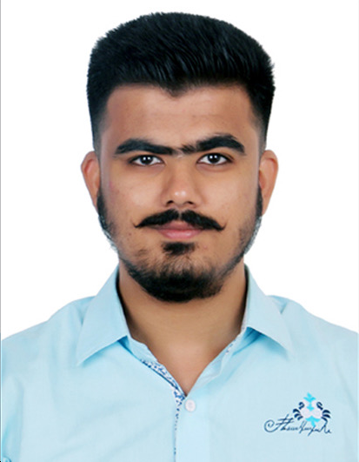
Siddhant Kumbhar
Siddhant is a Product Manager and Business Analyst with over 5+ years of experience in Banking and Financial Services, specializing in retail banking, capital markets, digital transformation, and application modernization. He has worked with leading institutions such as HDFC Bank and 5Paisa Capital, delivering solutions across customer acquisition, onboarding, servicing, and system integration. His expertise includes end-to-end product lifecycle management, business process transformation, and migration of legacy systems to modern cloud-based platforms, enabling improved efficiency, scalability, and customer experience.
Examples of relevant work
Led digital transformation of customer acquisition and lead lifecycle for Banking and capital markets platform, improving sales funnel visibility and conversion tracking.
Driving application modernization initiative including migration from legacy Zoho CRM to Microsoft Dynamics 365 platform.
Defined end-to-end retail banking processes covering lead management, onboarding workflows, and customer servicing journeys.
Designed and executed large-scale data migration strategy, ensuring accuracy, data integrity, and minimal business disruption. Enabled integration architecture between banking systems, telephony platforms, and external on-boarding/campaign tools.
Worked HDFC Bank, supporting key modules such as Leads, Accounts, Cases, and Activities. Also built workflows for LOS and LMS.
Gathered and documented business requirements (BRD/FRD) aligned with real-world banking operations and compliance standards. Managed UAT cycles and business validation, ensuring solutions meet operational banking scenarios and readiness for production.
Conducted API and system integration testing to support connected banking ecosystems. Supported process optimization and automation initiatives to improve turnaround time and reduce manual intervention.
Delivered stakeholder workshops, training, and adoption programs to ensure smooth transition to modernized platforms
Education
Bachelor of Engineering (Mumbai University)
Areas of Expertise:
Retail Banking
Digital Transformation & ApplicationModernization
Business Process Modeling
Agile Delivery & UAT Execution
CRM
Industry Experience:
IT Consulting, Business analyst
Banking

